Slide 1

Movie Dialogues:
An Analysis of Gender Representation & Language Use in Film

Slide 2
The Data: Cornell’s Movie Dialogue Corpus
283,250 lines from conversations
570 movies
9,035 speakers (4,302 labeled for gender)
Metadata: genre, release year, rating, gender, position in credits
https://www.kaggle.com/Cornell-University/movie-dialog-corpus
Notes:
Conversational

Slide 3
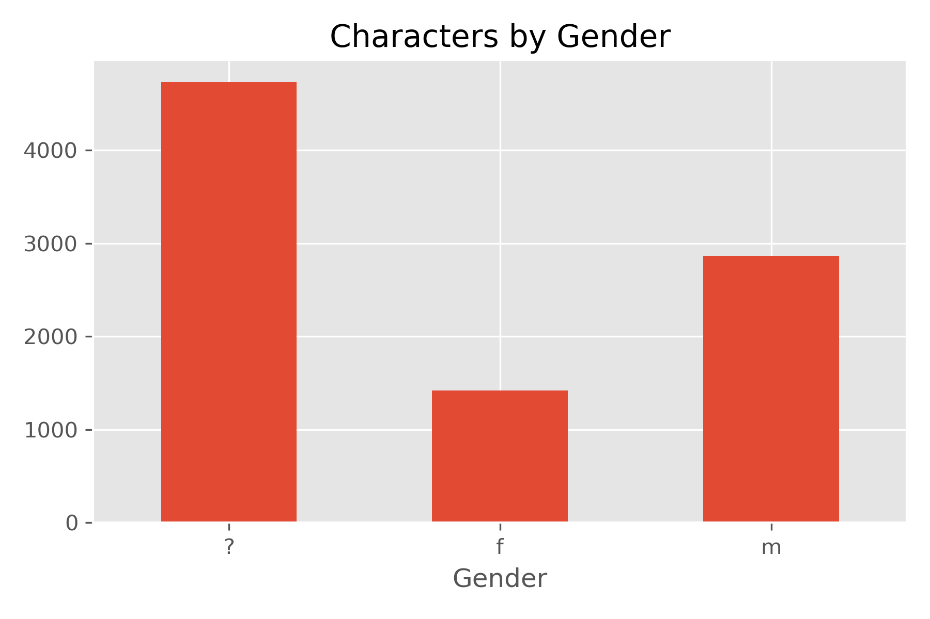
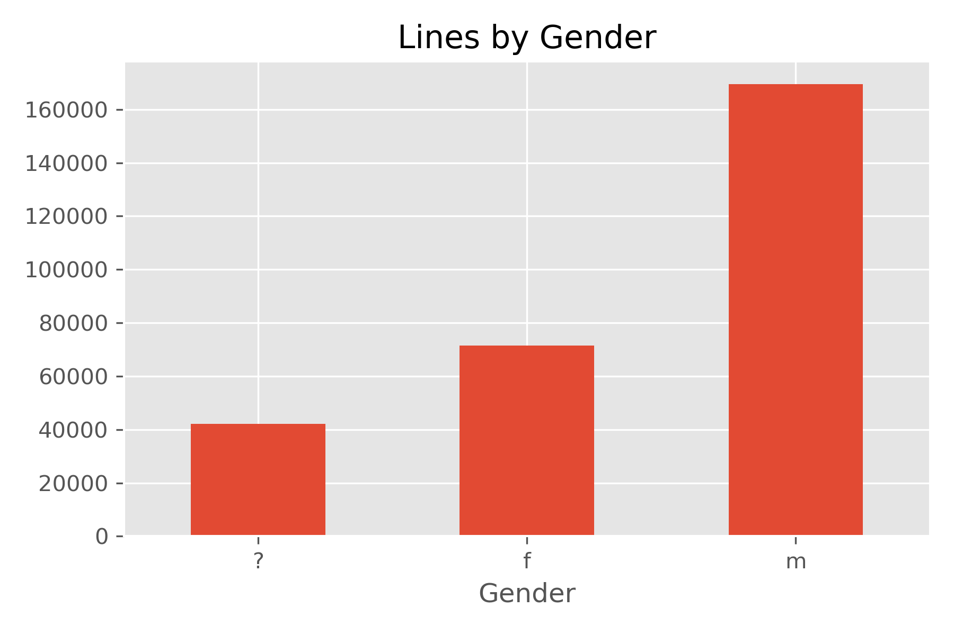
The Data: Gender Representation
Notes:
Conversational

Slide 4
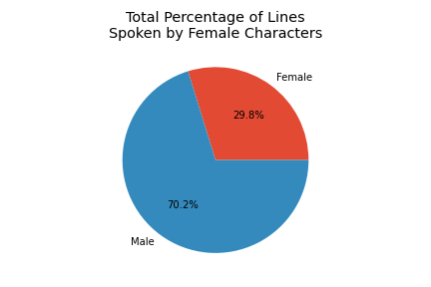
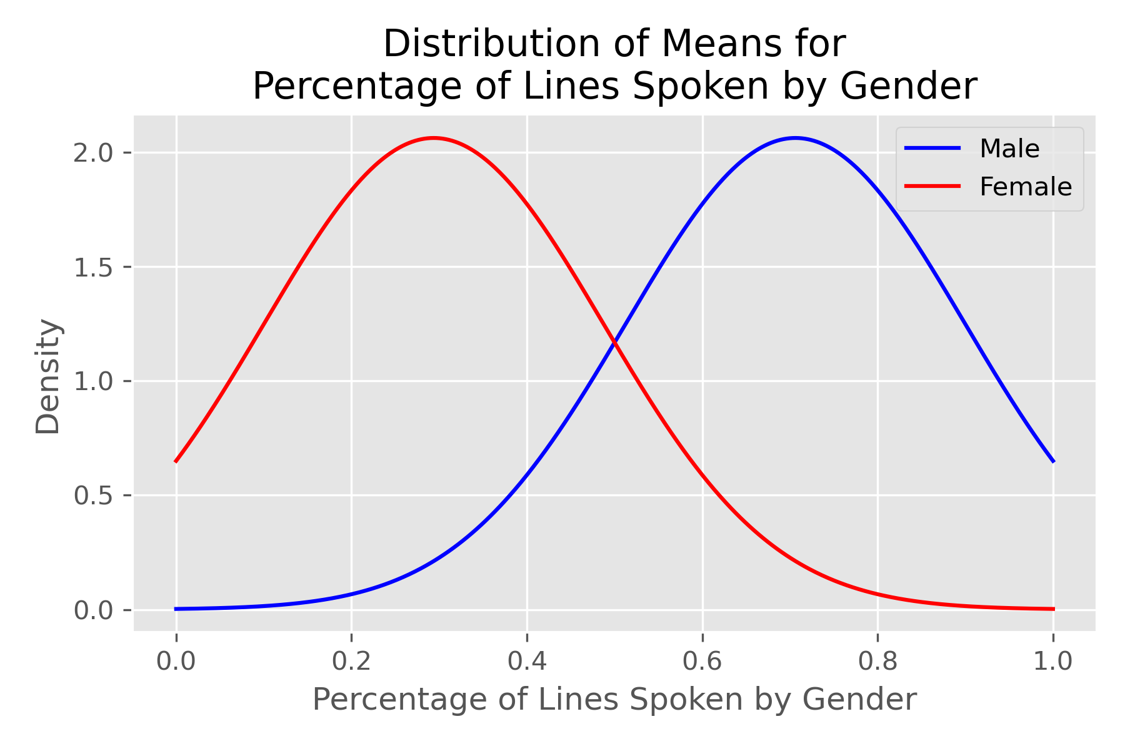
Female Representation in Movies
H0 = There is no significant difference in number of female and male spoken lines
H1 = Women have fewer spoken lines than men
p = 9.5E-134
p < alpha of 0.05, so the data is statistically significant
Reject the null hypothesis

Slide 5
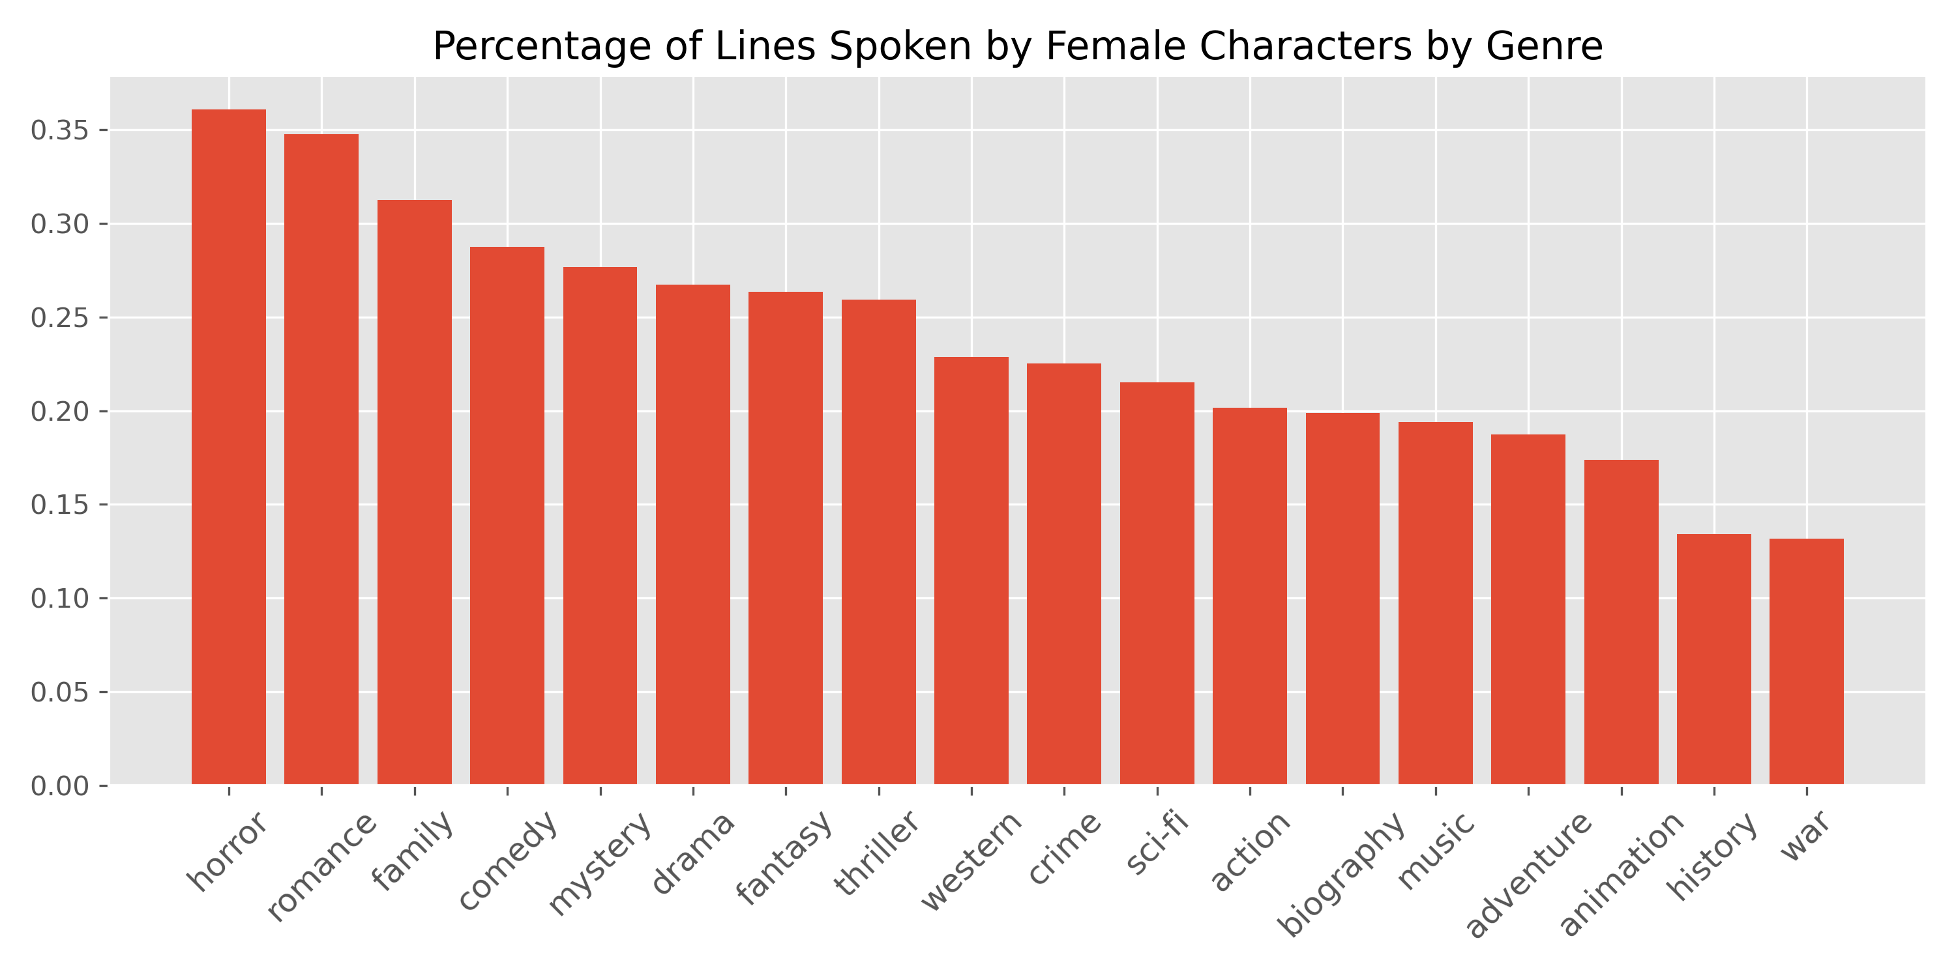

Slide 6
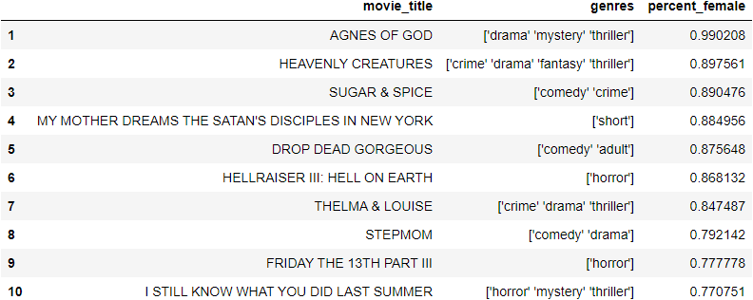
Top Movies by Percentage of Lines Spoken by Females

Slide 7
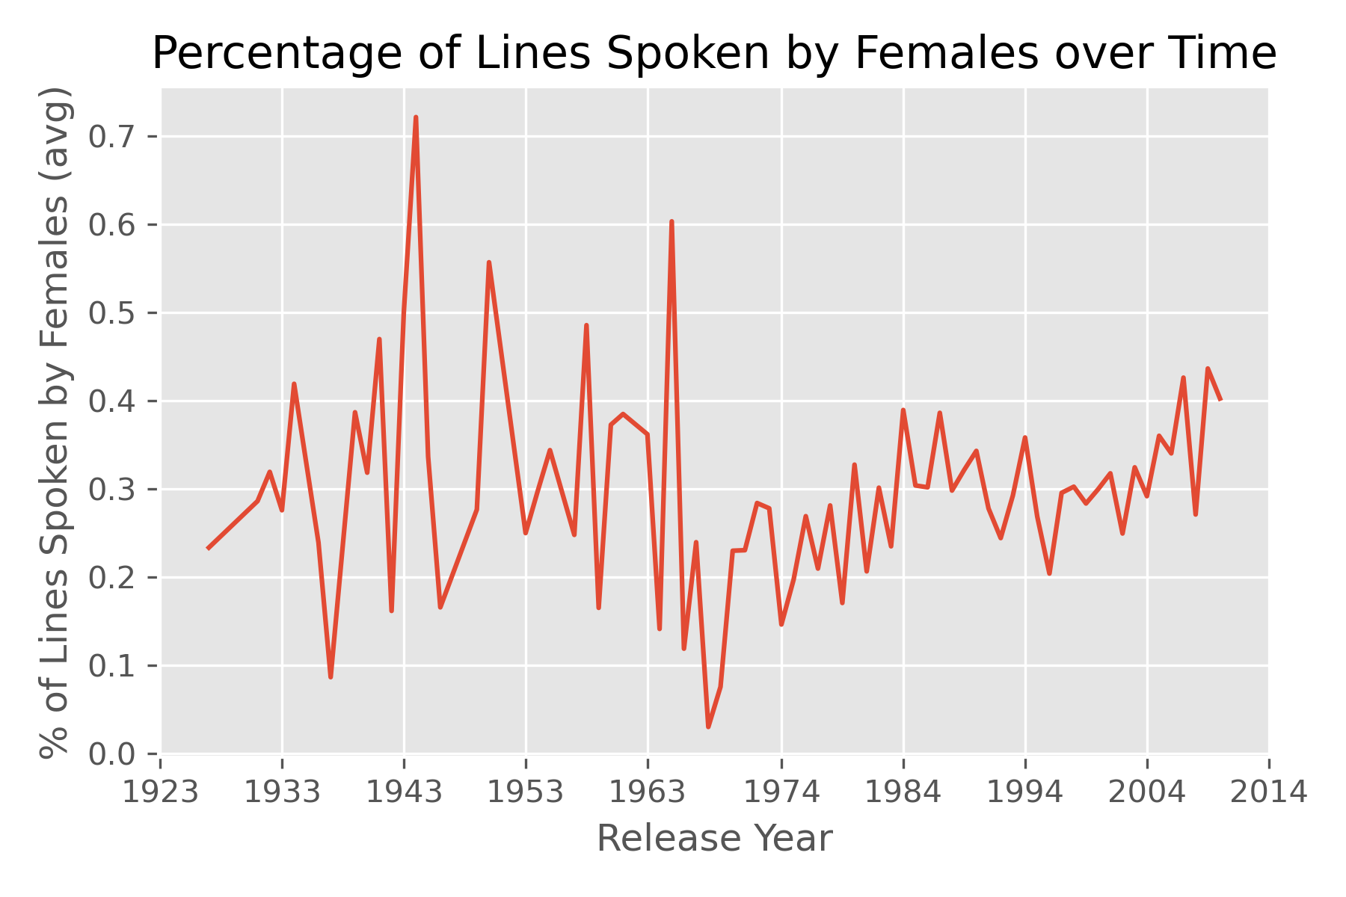

Slide 8
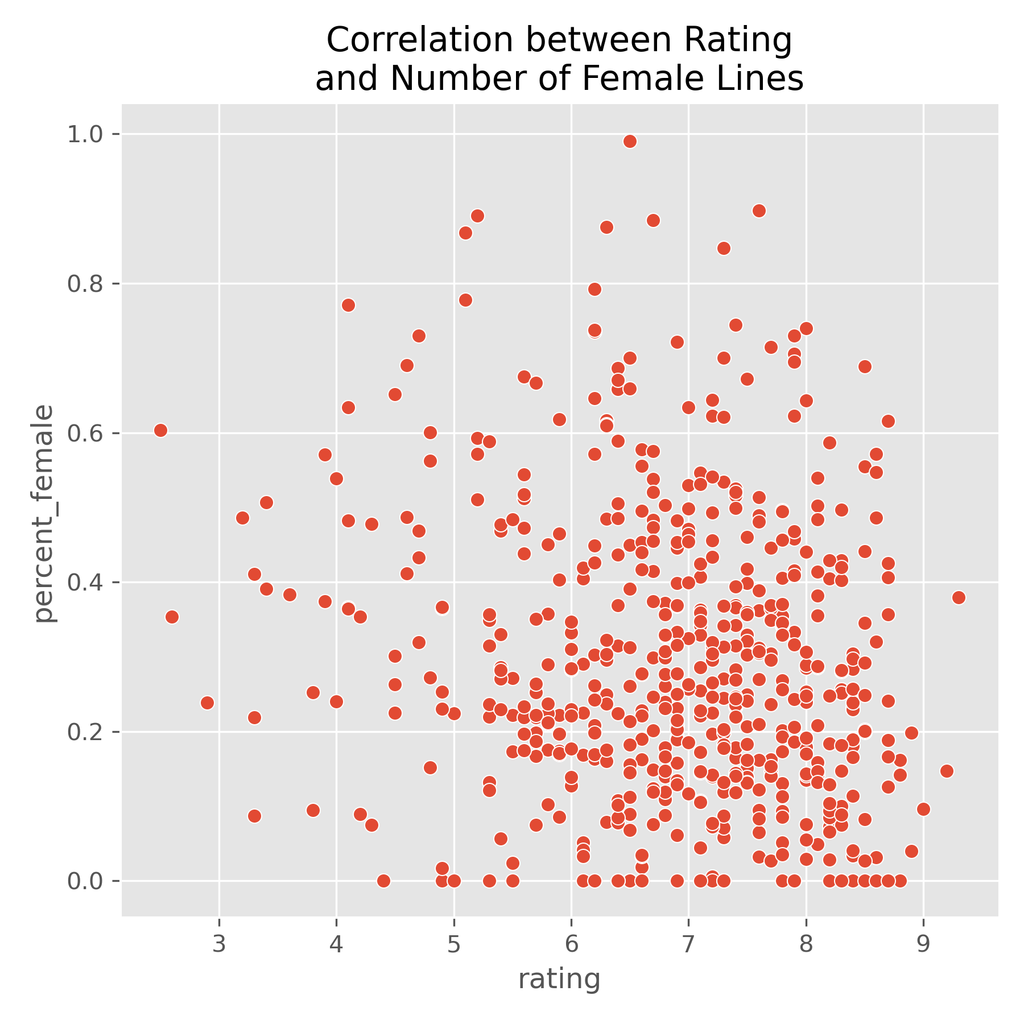

Slide 9
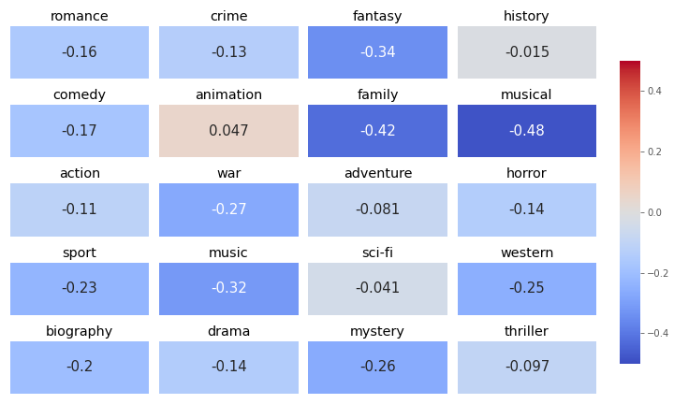
Heatmap of Correlation between Movie Rating and Number of Female Lines, by Genre

Slide 10
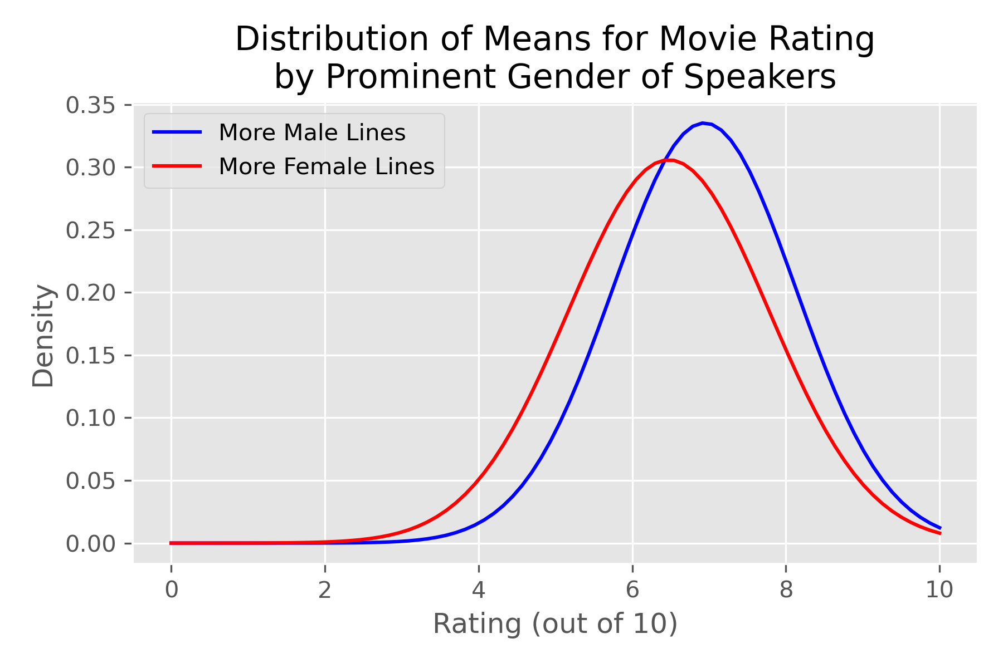
H0 = Rating does not correlate with most prominent gender of speakers
H1 = Rating negatively correlates with prominence of female-spoken lines
p = 0.0018
p < alpha of 0.05, so the data is statistically significant
Reject the null hypothesis

Slide 11
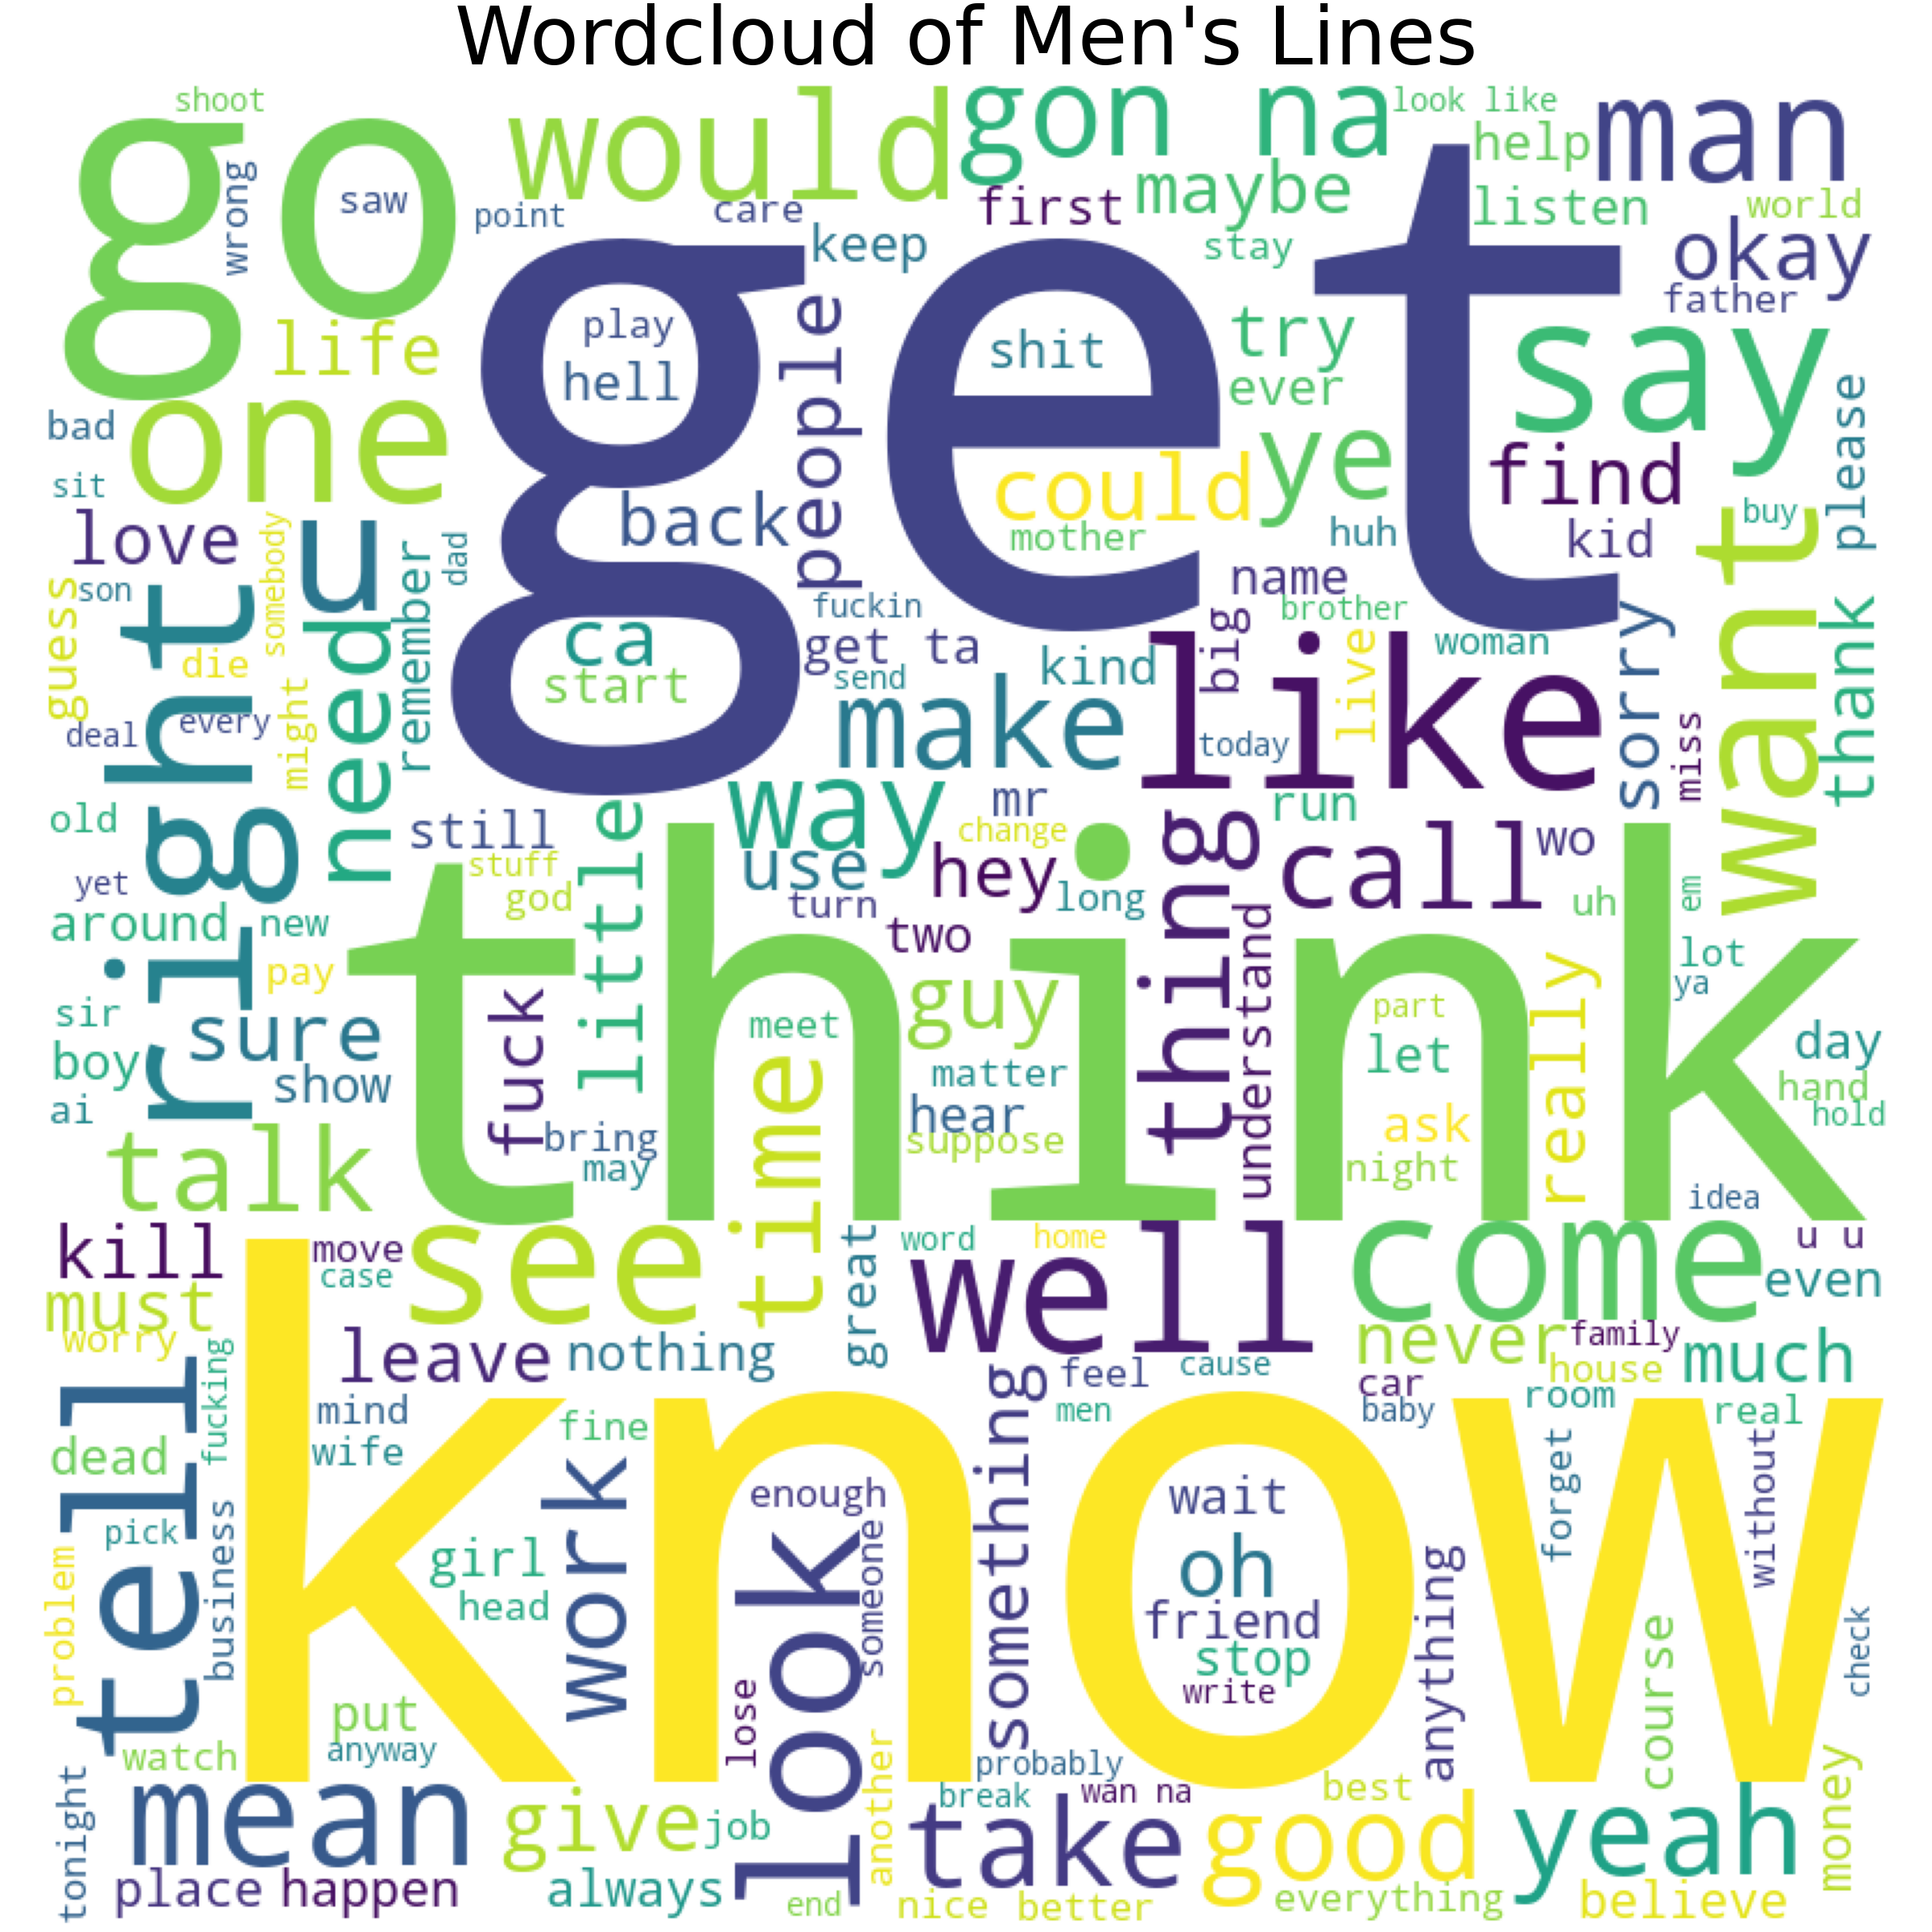
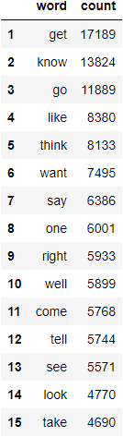
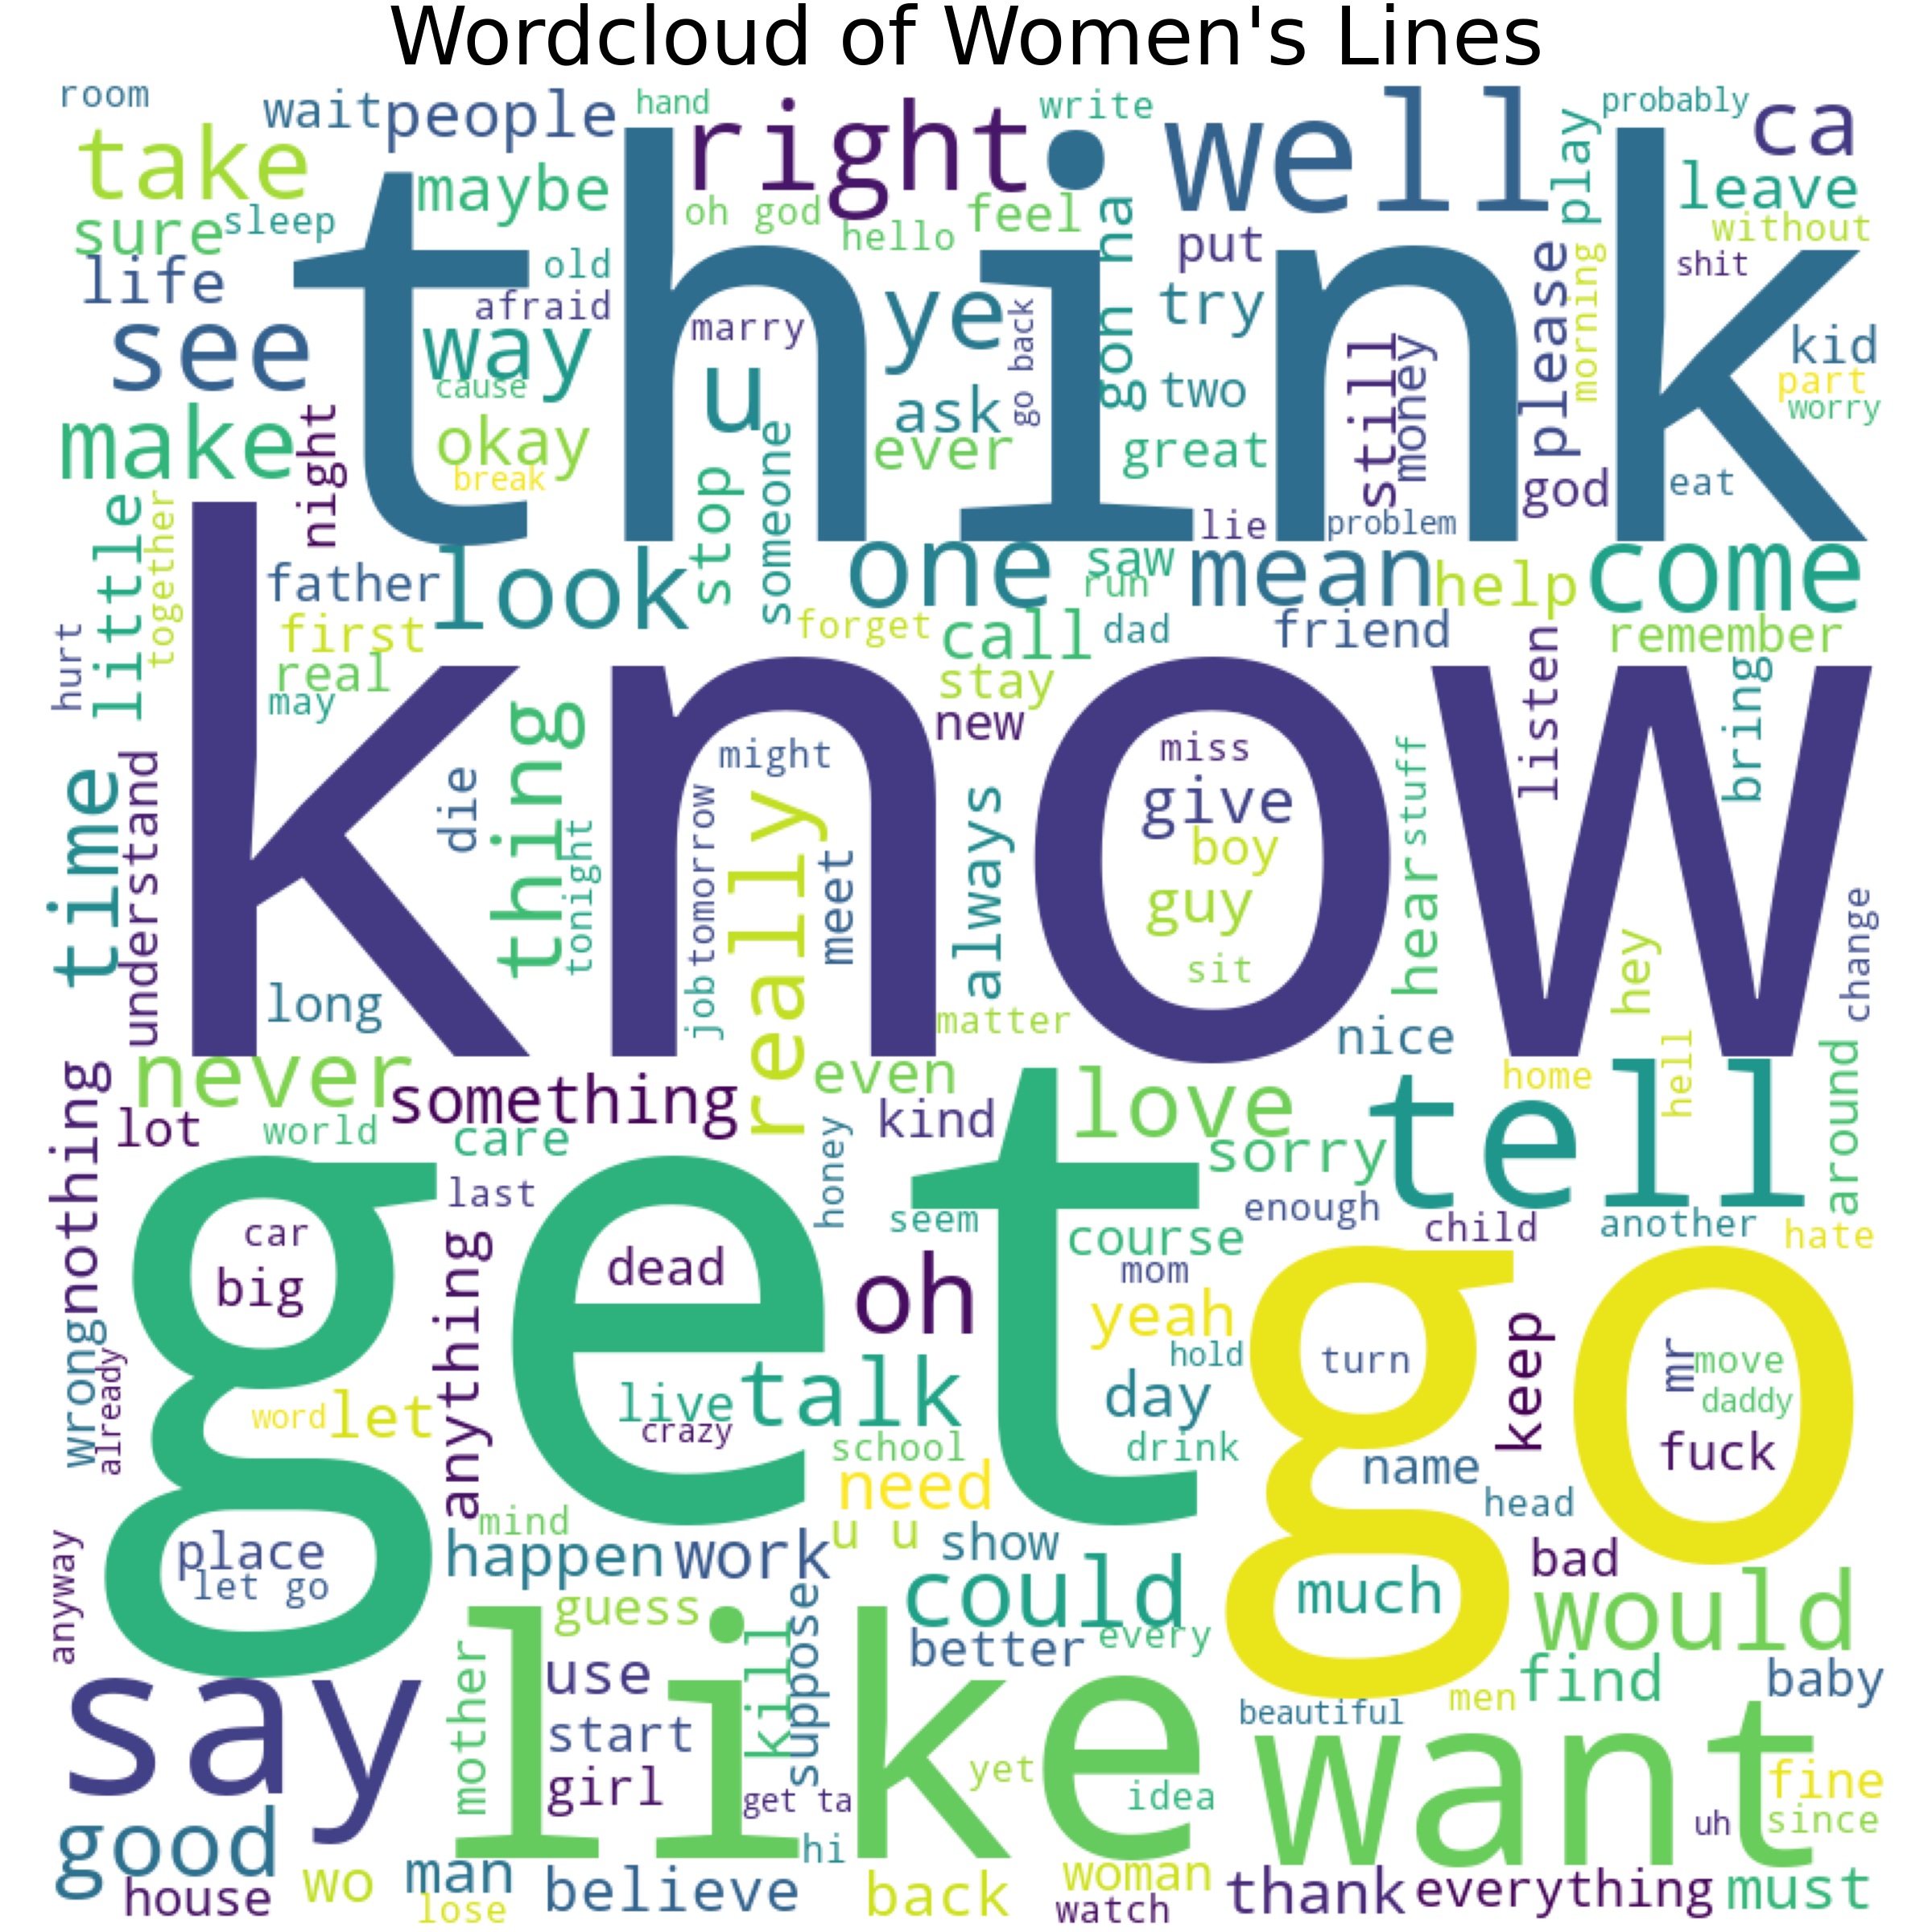
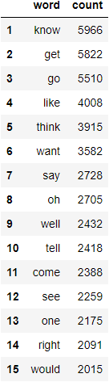
Word Clouds
Men
Women

Slide 12
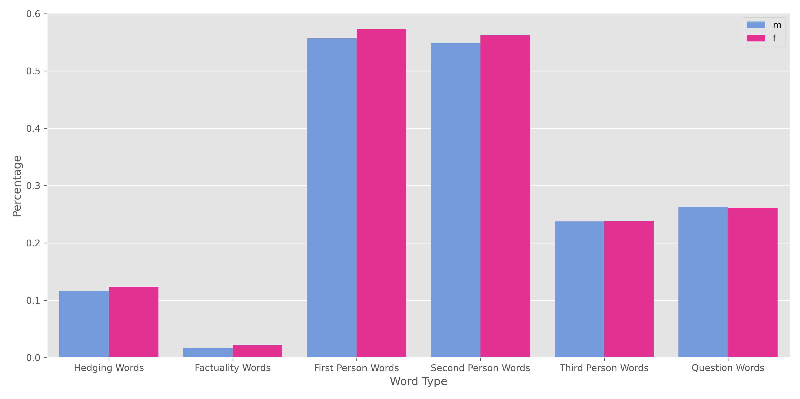
Word Types used by Gender
might, may think, possibly, maybe, seem | really, definitely, absolutely, positive | I, we, my | you, your, yourself | she, he, her, him, they, their, them | how, who, when, what, where, why

Slide 13
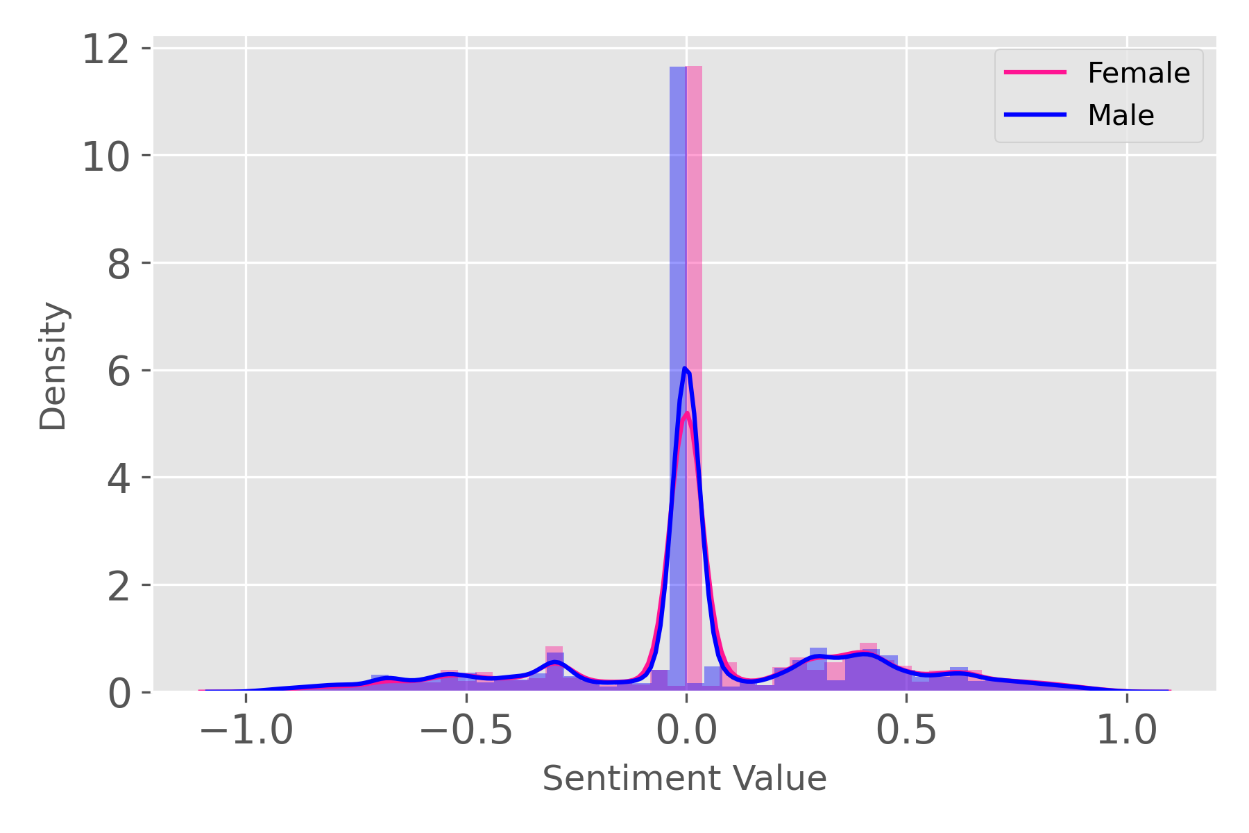
Sentiment Analysis

Slide 14
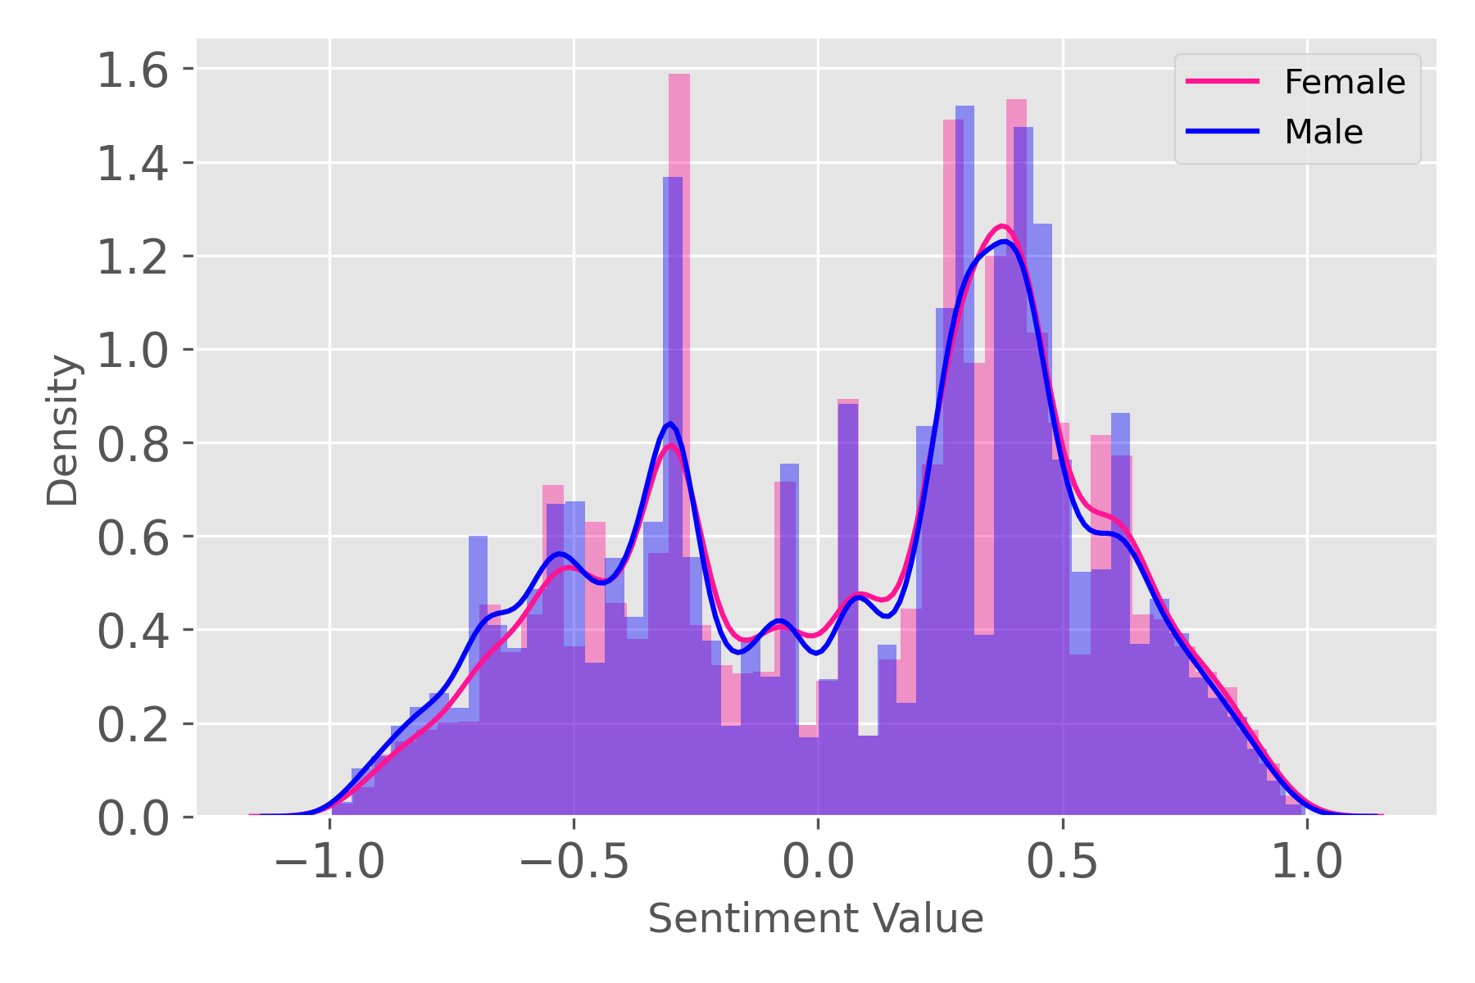
Sentiment Analysis (adjusted for non-zero values)

Slide 15
Conclusion & Future Work
Male speakers are significantly better represented than females in film
Generally, films with more female speakers are rated more poorly
Little difference in actual language use between genders
Future Work:
Break down language use by genre, rating
Different strategies to identify language use (e.g. type of verbs used, politeness indicators)
Better training for sentiment analysis

